Slide 1


Introduction to Atliq Hospitality Data Analysis
Atliq Hospitality's data analysis encompasses valuable insights from various datasets. This report outlines key findings and recommendations from the analysis.
by Naman Kedia

Slide 2
Overview of the Datasets
1
dim_date
2
dim_hotels
3
dim_rooms
Contains daily attributes relevant to bookings.
Details about different hotels including location and amenities.
Information on room types and availability.
4
fact_aggregated_bookings
5
fact_bookings
Aggregated booking data summarizing trends.
Detailed record of individual bookings.

Slide 3
Dimension Tables: dim_date, dim_hotels, dim_rooms
dim_date
dim_hotels
dim_rooms
Important for understanding booking patterns over time.
Critical to assess hotel performance and customer preferences.
Essential for managing inventory and room types offered.

Slide 4

Fact Tables: fact_aggregated_bookings, fact_bookings
Table
Description
fact_aggregated_bookings
Summarized historic booking data analyzed for trends.
fact_bookings
Transaction level data capturing each booking detail.

Slide 5

Data Cleaning and Preprocessing
Step 1: Data Quality Assessment
1
Evaluated datasets for duplicate and missing values.
2
Step 2: Data Transformation
Standardized formats for consistency across datasets.
Step 3: Error Correction
3
Corrected inaccuracies in entries to enhance reliability.

Slide 6
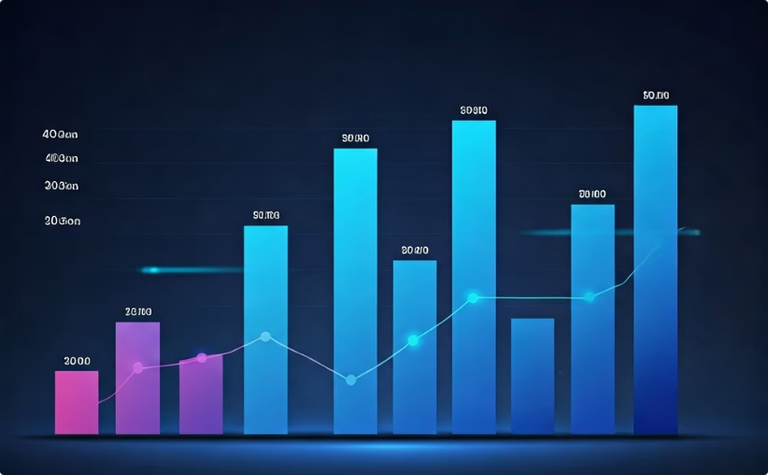
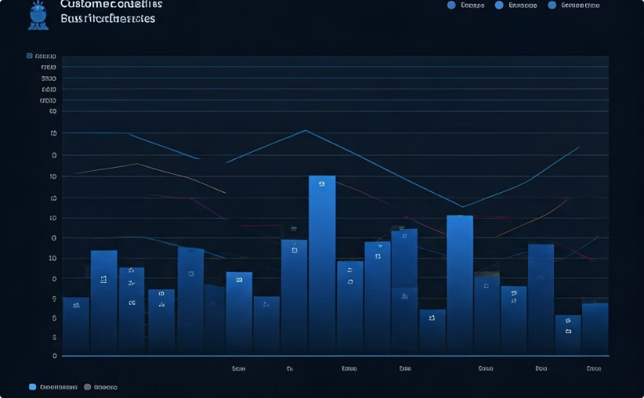
Exploratory Data Analysis
Booking Trends
Room Type Preferences
Illustrates fluctuations and patterns in hotel bookings.
Highlights the most sought-after room types among guests.

Slide 7
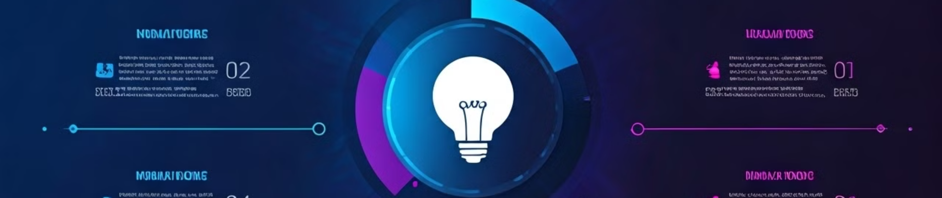
Insights and Findings
1
Increased Bookings
2
Room Preferences
3
Booking Channels
Notable rise in bookings during holiday seasons.
Luxury rooms maintained higher occupancy rates than standard ones.
Online bookings surged compared to offline methods.

Slide 8
Conclusion and Recommendations
Conclusion
Recommendations
Future Analysis
Data analysis provides a roadmap for strategic improvements.
Enhance online marketing and optimize room offerings.
Consider implementing machine learning for predictive analytics.

